Slide 1
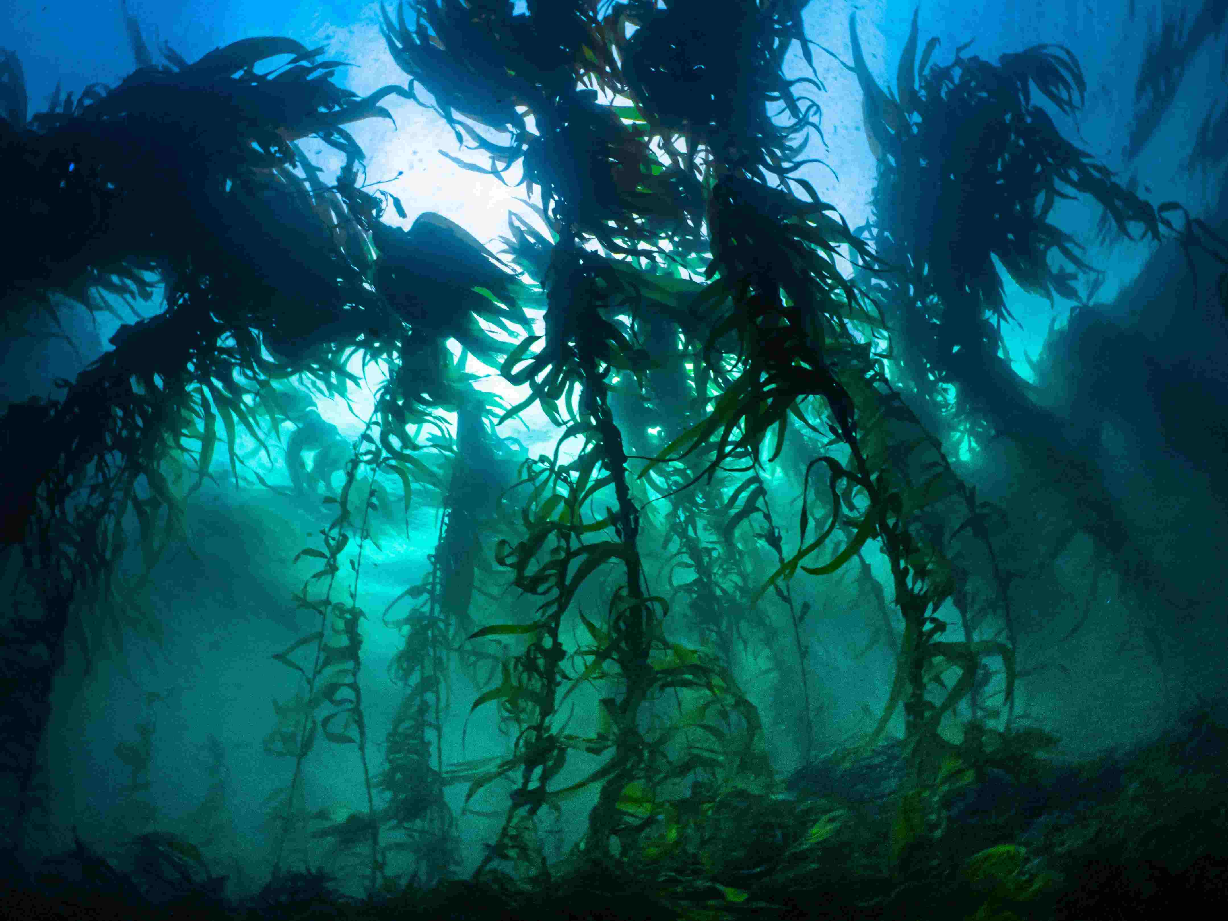

Lesson plan:
Ecosystem restoration
Teacher Resources linked to the Big Fish card game
All photography in the document is by Matt Testoni and should only be used for teaching purposes as intended here
Resource development supported by Inspiring Australia Tasmania

Slide 2
Australian Science Curriculum
Year 9
Outcomes:
This lesson targets the Biological sciences focus on interdependence and interactions within ecosystems and how biological systems respond to change.
“Ecosystems consist of communities of interdependent organisms… matter and energy flow…” ACSSU176
Science Inquiry (collecting/analysing data from a model)
Science as a Human Endeavour: Evaluating management responses and explaining how science connects to technology and engineering in a modern society.

Slide 3
UN Sustainable Development Goals
Goal 14: Conserve and sustainably use the oceans, seas and marine resources for sustainable development

Slide 4
Core concepts
Many marine ecosystems have been degraded and affected by overfishing, pollution and climate change. It is estimated that almost 90% of all fish larger than 1kg in size have been lost due to unsustainable fishing practices.
Many fisheries in Australia and globally have collapsed, meaning that fish population biomass (total weight of all the fish in a population) has been reduced to less than 10% of their original unfished biomass. Such collapsed fisheries cannot sustain any more fishing.
By allowing degraded ecosystems and collapsed populations to recover we can bring back abundant fisheries and healthy thriving oceans.
In this lesson students start with a “degraded ecosystem” as their fishing spot. This ecosystem only has a few fish left.
Students then explore best options to restore the ecosystem, while at the same time managing unpredictable weather events and illegal behaviour by other people.
Example strategies of restoring ecosystems include the construction of shellfish reefs, the implementation of marine parks, improved fishing regulations, or seaweed (kelp) restoration.
By protecting big fish and implementing management strategies students discover that marine ecosystems can recover relatively fast.

Slide 5
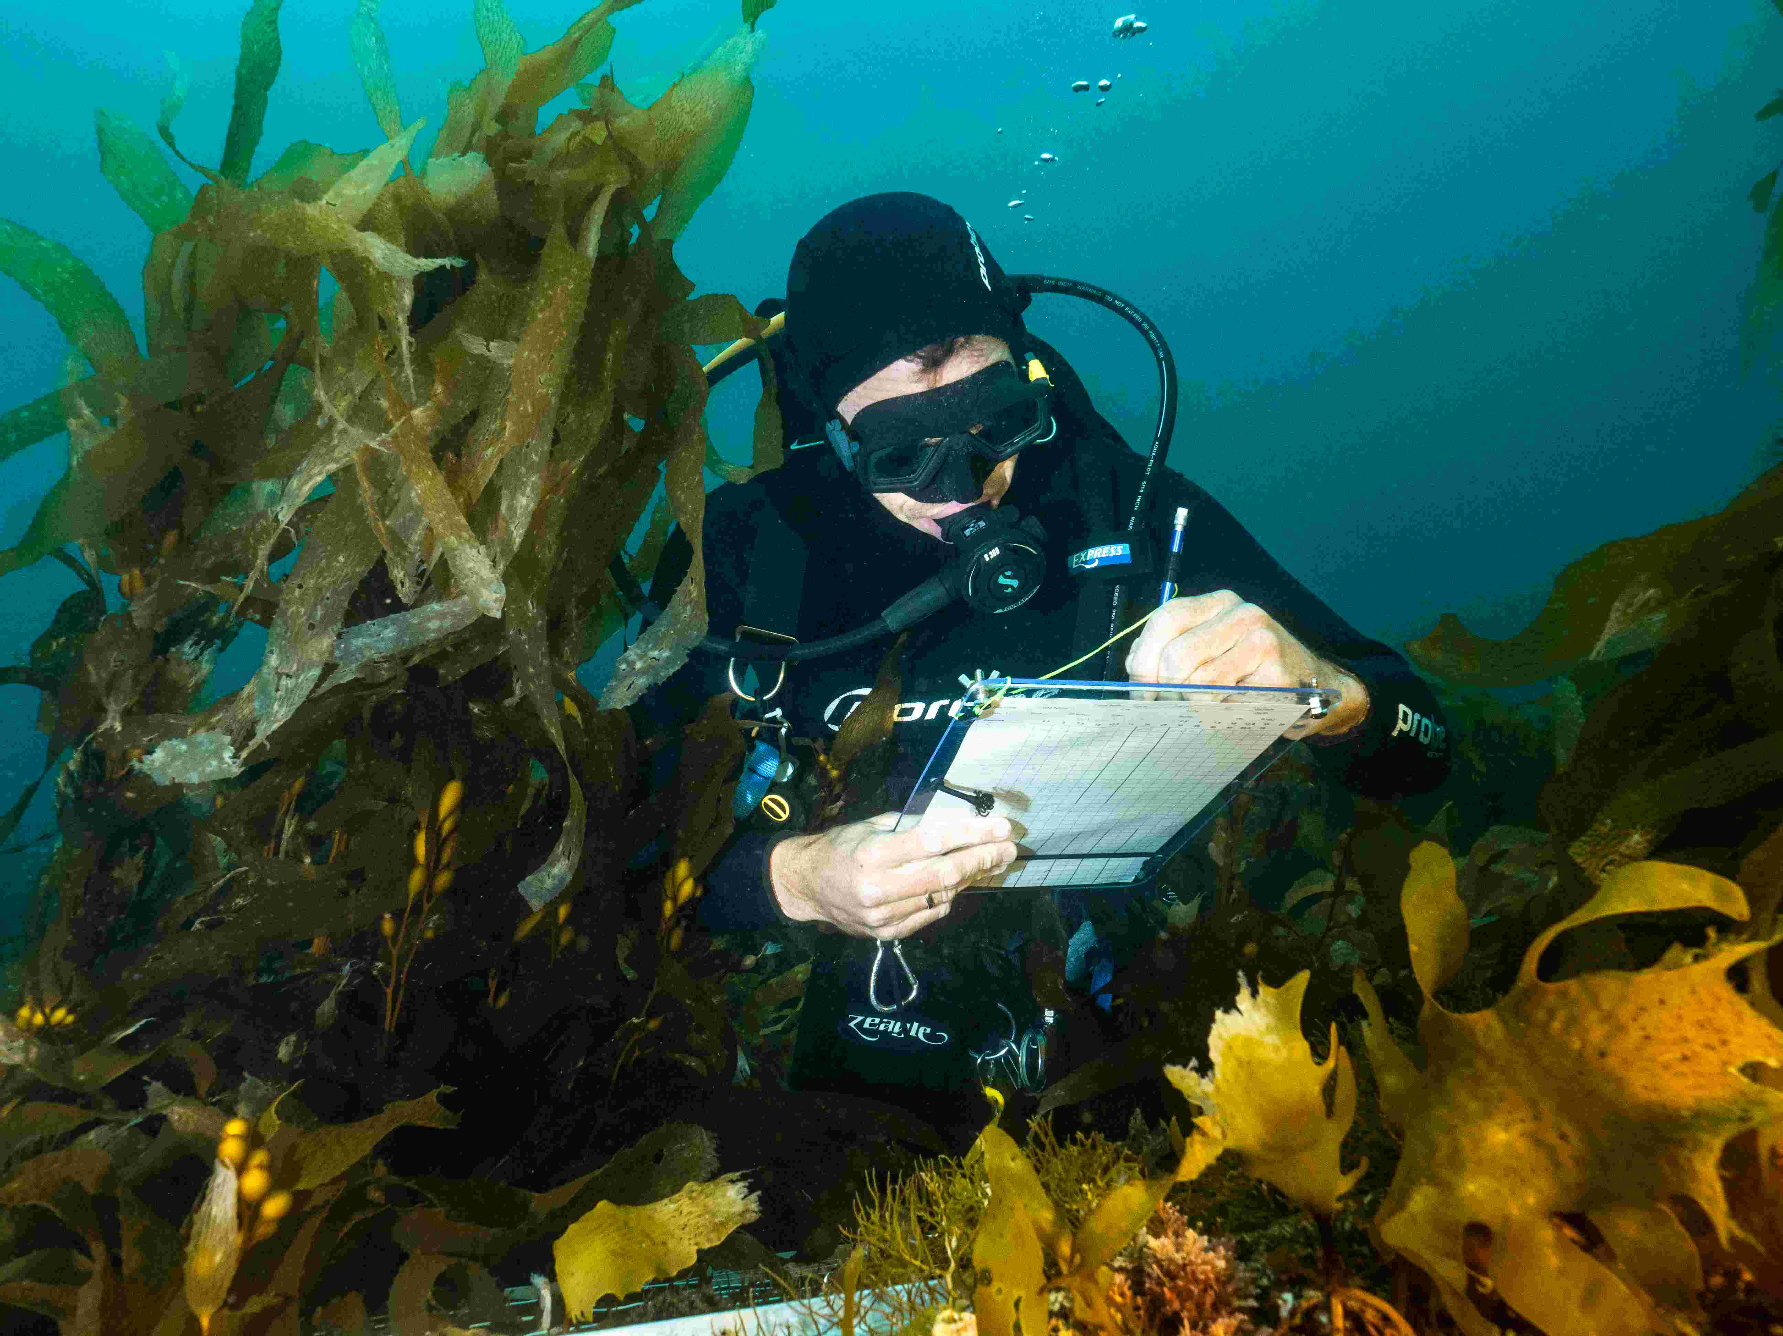
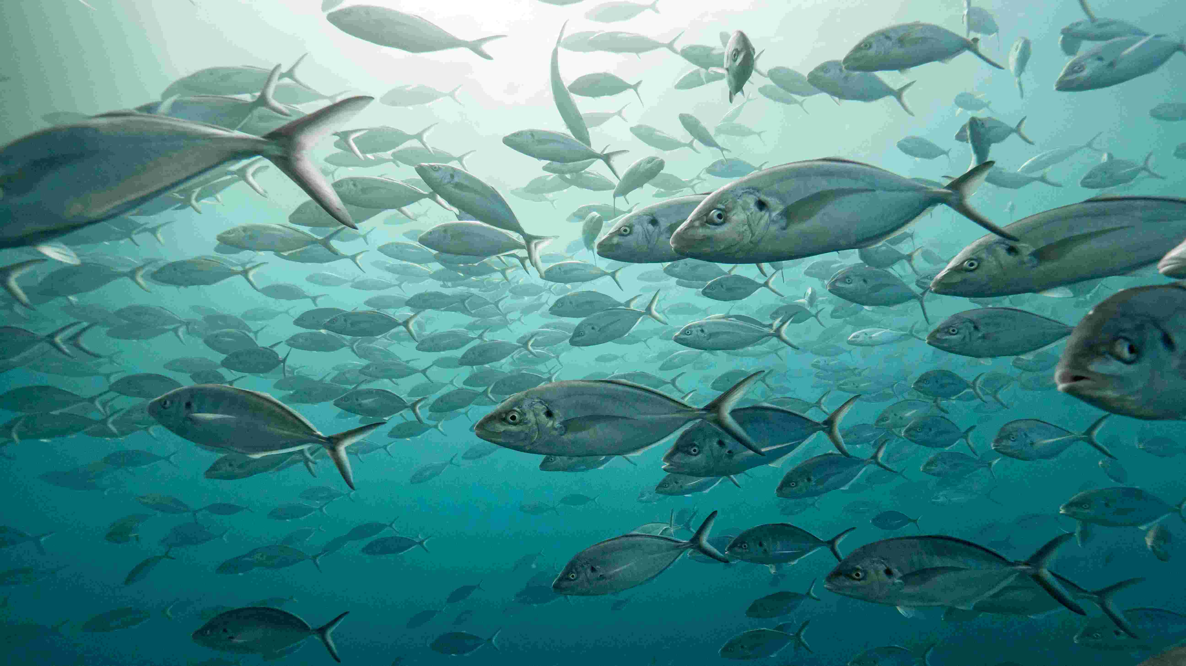

Slide 6
Learning intention
Students use the Big Fish game (as a simulation) to model strategies for ecosystem restoration in Australian temperate reefs.
Seaweed, Marine Parks, Shellfish Reefs, Sharks = possible strategies for restoring ecosystems include Wild cards such as.
Heat Waves and Illegal Fishing = threats to restoration include. Students need to consider these events when planning and strategising the restoration.
Real-world context: ecosystems such as the D’Entrecasteaux Channel in Tasmania, Port Phillip Bay in Victoria and areas of South Australia (affected by the recent algal bloom) are a shadow of their former health. But good management and right strategies can help restore them to productive and healthy ocean ecosystems.

Slide 7
Success criteria
By the end, students can:
Test and understand restoration strategies. Student use the Big Fish card game as a model to explore different strategies but are also able to connect it to real world events.
Explain (with evidence from the game and real world) the way different restoration options work and how they can interact with other options and the ecosystem in general.
Propose a plan for restoring a degraded marine ecosystem. Provide evidence and examples of how effective the proposed strategies have been in the past, including the successes and failures.

Slide 8
Duration
2 × 50–60 min lessons (play + analysis/write-up)
Resources
Big Fish Card Game (one deck per group of 4 if possible)
Cardboard, big sheets of paper or postit notes with a whiteboard used to map and plan the restoration.
Template for creating a ministerial briefing (available here)
Students also need to select (or be provided by the teacher) an example environmental issue (overfishing, pollution, too much tourism, invasive species, or other) that has affected their ecosystem and which they are going to address.

Slide 9
Example issues to address:
1) The local bay has seen a large drop in fish populations in recent decades. This has been due to overfishing and pollution. The community wants safe water way to swim in and more abundant fish population to enjoy.
2) Climate change and habitat destruction has meant that the local fish populations have crashed. The area is important for recreational fishing, bird watching and ocean-based tourism, such as snorkelling and diving. A plan is needed to restore the marine environment for both environmental and economic reasons.
3) Local bay has been overrun by sea urchins which are destroying kelp. This is damaging local fisheries and tourism. People want their healthy kelp forests back.

Slide 10
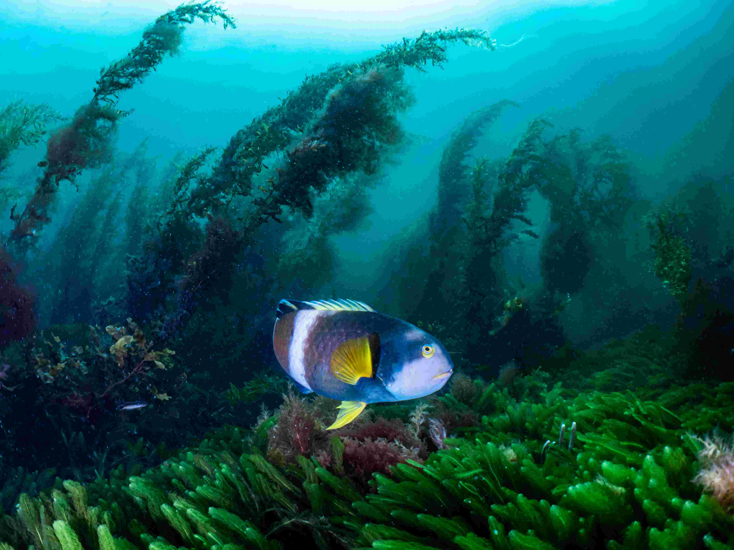
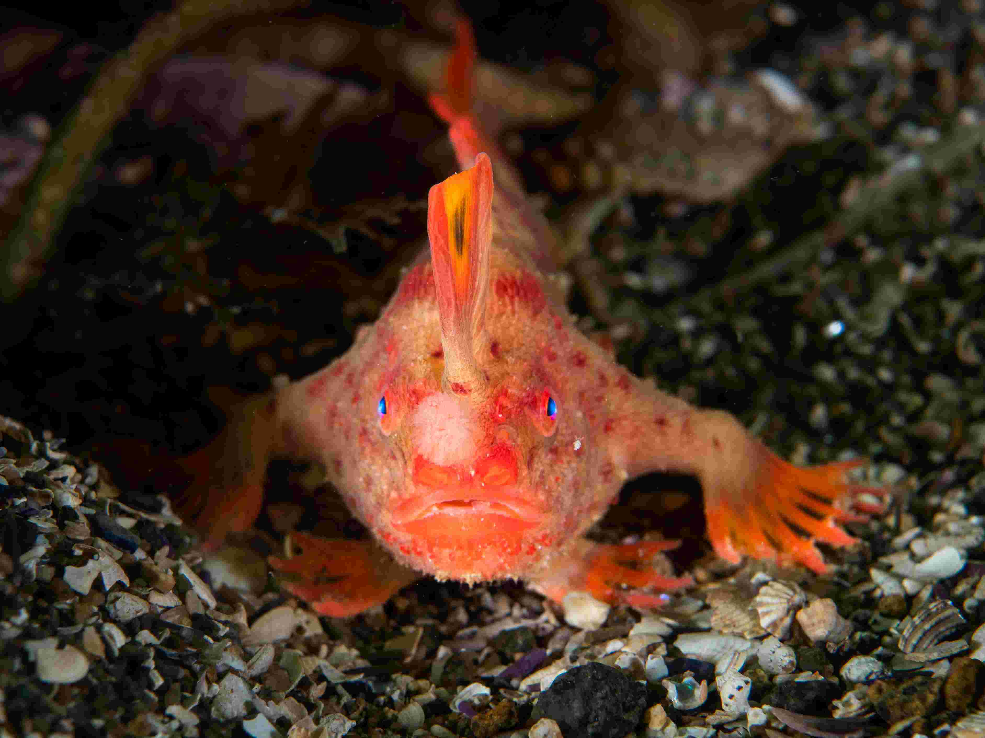
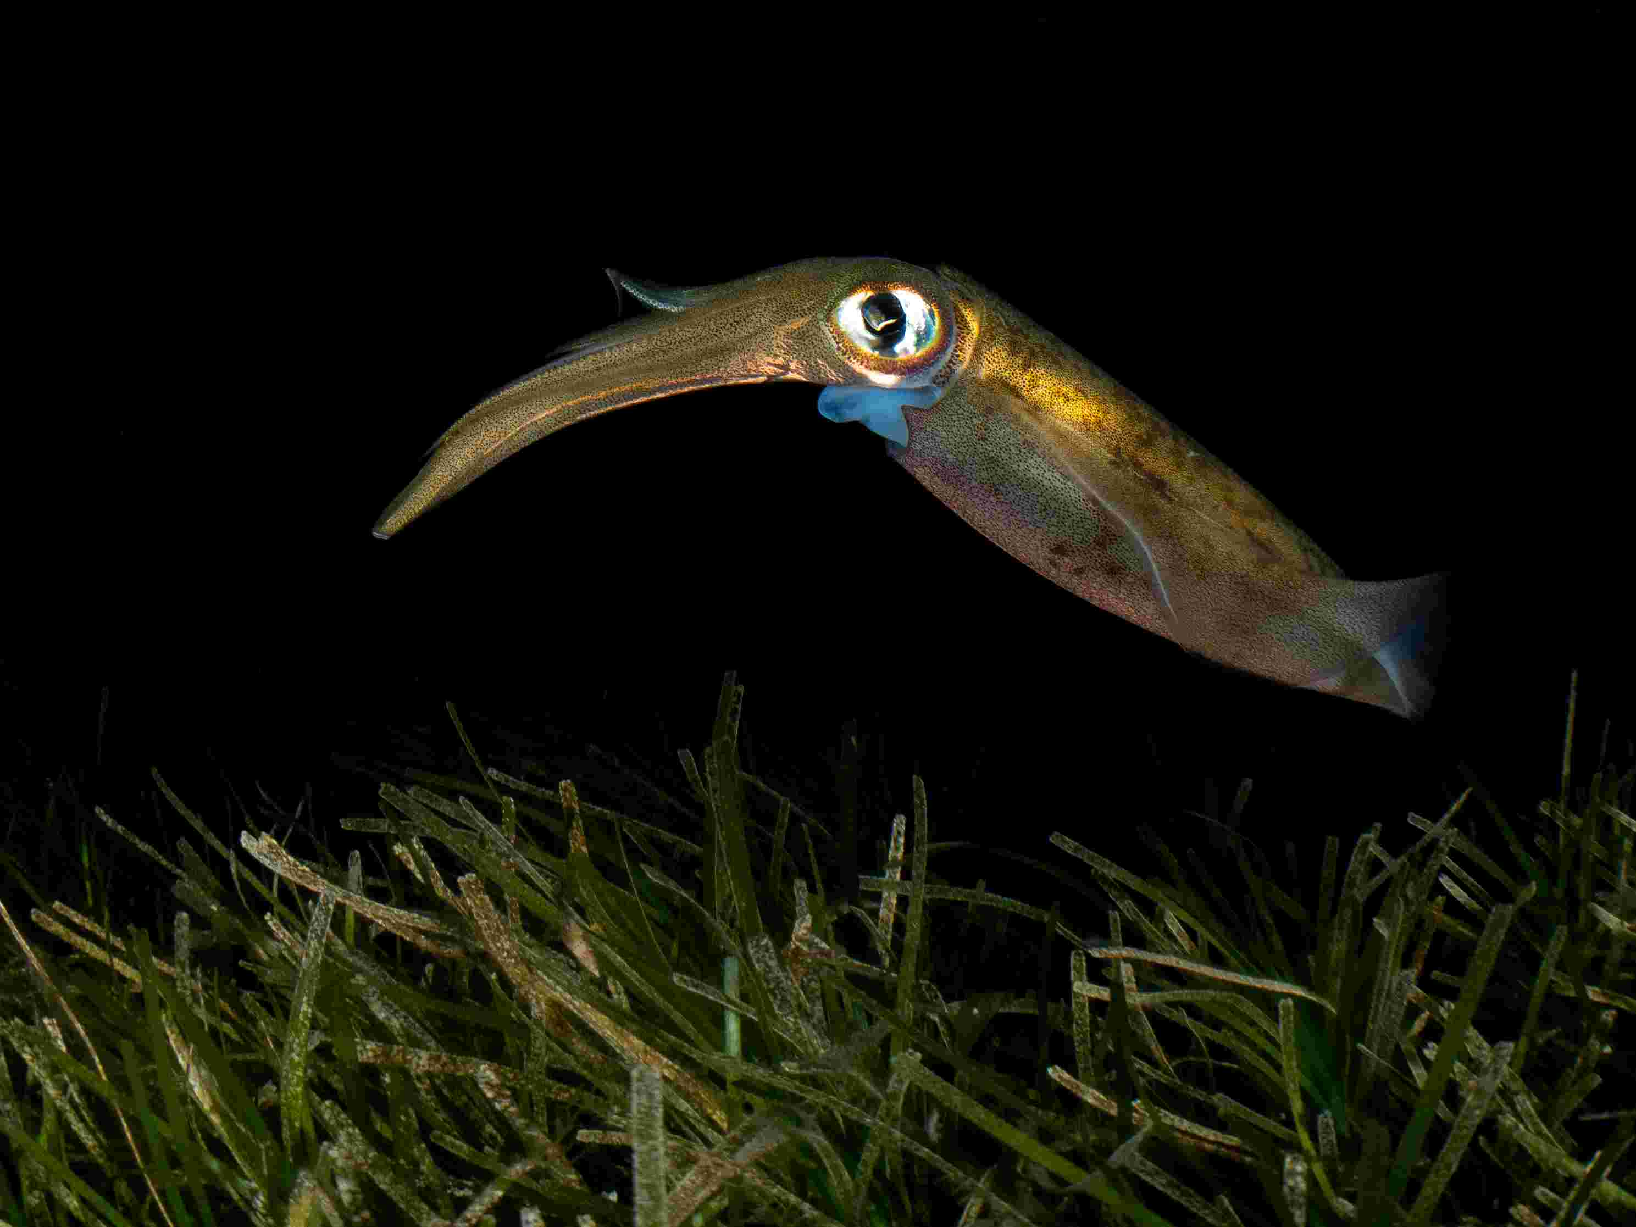

Slide 11
Assessment
Students will:
write a 1-2 page ministerial brief from a science advisory team addressed to a Minister. The brief outlines a clear strategy for ecosystem restoration to address the selected environmental issue that the Minister wants to fix.
(optional) present the ministerial brief in an oral presentation. To make this more interactive, all students in the class get allocated $500 of “monopoly” money or other fake bills each. Each student give their money to the restoration projects they liked most.
(optional) present the mind-map illustrating the though process, explaining positives and negatives of each restoration option and how it affects other species and society.

Slide 12
Tips for assessment
Ensure this brief has correct and clear information to be as accurate as possible, while also being short and focused.
The brief should contain both the negatives and positives that will arise from implementing the restoration plan. Remember, the brief is used to inform the minister, not to push for a specific action. The minister is already interested in restoring the ecosystem, but they just need to decide on the best option.
It can be useful to look at all the Event and Wild cards in the full Big Fish card game and its expansion to understand more options for restoration
For a more advanced assessment, students could present several potential plans (which perhaps have been discussed in media) and rank them from best to worst, based on their analysis. For example, marine parks will provide more fish but can have negative press, building shellfish reefs may cost a lot of money but will be popular with people, an education program (i.e. a game about how sharks produce a healthy ecosystem) will be popular but may be less effective.
The brief should also stakeholder concerns, not just the core science. For example, if ecosystem is overfished the concern in society is that there is not enough fish to catch or see. Remember that the minister responds to society pressure mostly.
The mind-map can show their thought process for the development of restoration plan. It can included references to the scenarios from the Big Fish card game and other resources provided in this lesson or discovered by students. This would be like demonstrating the working out process in a maths question.

Slide 13
Checklist for students (what should be included in the brief):
My recommendation includes BOTH prevention (e.g. regulation) and restoration.
I explained the issue and what is causing the problem (habitat destruction → low fish stock) in my own words.
I compared different restoration options with at least one trade-off (e.g. one is more expensive, the other will take longer)
I included a monitoring plan with measurable indicators and success criteria (how will we know that restoration is working?)
My writing is brief, formal and decision-focused (like advice to a Minister)

Slide 14
Setup
The game starts with each student (or pairs of students, if playing in pairs) has a fishing spot with 1 Big fish, 1 Medium fish and 1 Juvenile fish. Each student also get the hand (cards in their hand) of 6 fish cards. Include only fish cards in the hand distributed to each student.
In this setup the face-up cards in the middle consist only of Wild cards. They include: Large Shark, Heatwave, Shellfish Reef, Marine Protected Area, Giant Kelp, Seaweed and Illegal Fishing.
Remove all other Wild cards from the deck. The deck should only have the aforementioned Wild cards and Fish cards. Have a ratio of roughly 50% Wild cards and 50% Fish cards. Remember you don’t need to use the whole deck for every game, as there are deliberately a lot of cards.
Do not use Event cards in this setup. That is no events happen at the end of each round.

Slide 15
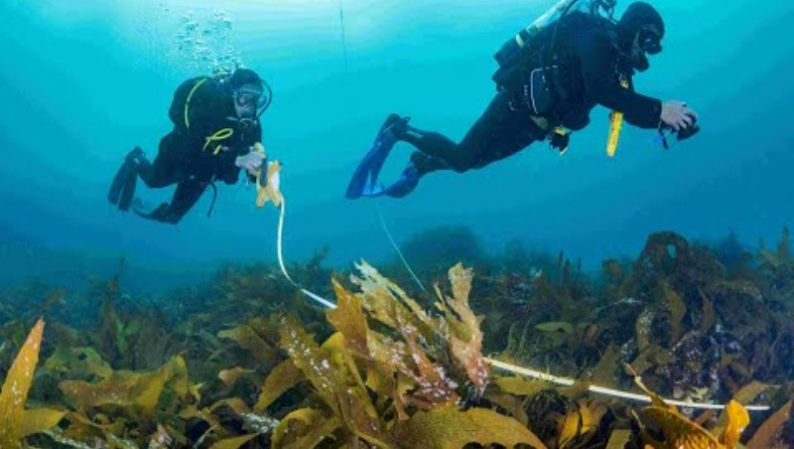
Scenario Setup Instructional Video
https://youtu.be/GdK9nMY1PHw

Slide 16
Gameplay
This scenario takes the core concept and gameplay of Big Fish card game and alters it to create a faster and more educational experience. The game is as normal except that some Wild cards are not used and there are no Event cards at the end of each round.
Here is a short video explaining the full usual game play
When playing the game, in each round students can take their turn all at once (which is faster) or in a consecutive order (which could be more interactive).
Play each game for 5 rounds or until students grasp the concept.
Students can play with or without the fishing step. This should ideally be decided depending on the scenario. For example, if scenario is about fishing, it might be useful to include the fishing step. If scenario is about pollution, fishing step may be omitted.

Slide 17
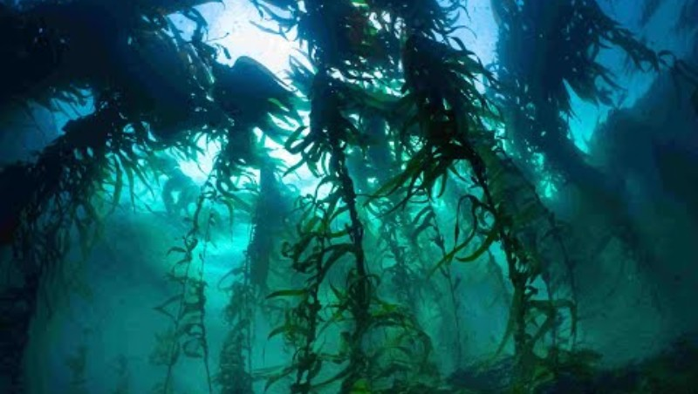
Gameplay Video

Slide 18
Skills
Teamwork
Collaboration
Problem solving
Critical thinking
Design thinking
Assessing and evaluating alternatives
Finding correct information
Summarising information accurately and concisely

Slide 19
Word list, key terms and concepts
Restoration
Ecology
Sustainability
Ecosystem interactions
Climate change
Pollution
Policies
Heatwaves
Ecosystem models
Human impact
Fishing selectivity
Cascading effects
Stakeholders
Community
Fishing pressure
Trophic effects
Policy evaluation
Management strategy evaluation

Slide 20
Additional resources

Slide 21
Ministerial Briefing Template P1 (also see downloadable word doc and PDF)
Headlines; To Environment Minister, From…., Date 00/00/00, Subject……
Purpose (2-3 lines): what decision is being sought, i.e. solution to historic environmental issue
Problem Summary (one paragraph): what's gone wrong and why it matters.
Local Context (one paragraph): what is the ecosystem, what values are at risk and who is affected, i.e. community outdoor space or productive fishing ground.
Evidence of the problem (short paragraph): What is happening
Options (advanced lesson): Such as marine park creation or fishing rule adjustments.
Recommendation (1 line): a clear sentence indicating the choice.

Slide 22
Ministerial Briefing Template P2
Timeline (1 sentence): include phases i.e. planning-works-assessment or policy implementation-monitoring-adaption.
Risks and mitigations:
  Risk: community opposition / user conflict → Mitigation: stakeholder consultation
  Risk: restoration fails due to site conditions → Mitigation: pilot sites + adaptive management
Evaluation (1 paragraph): choose measures of evaluation such as water clarity, fish stocks or community feedback.
Communication (2 lines): how to communicate problem and solution quickly and concisely to the public.

Slide 23

The United Nations Environment Program video about shellfish reef restoration in South Australia and harmful algal blooms that hit the state in 2025 (14 mins)
https://youtu.be/Ji88_cBSPfo?si=bWl8D_vZrr8zkKyW

Slide 24
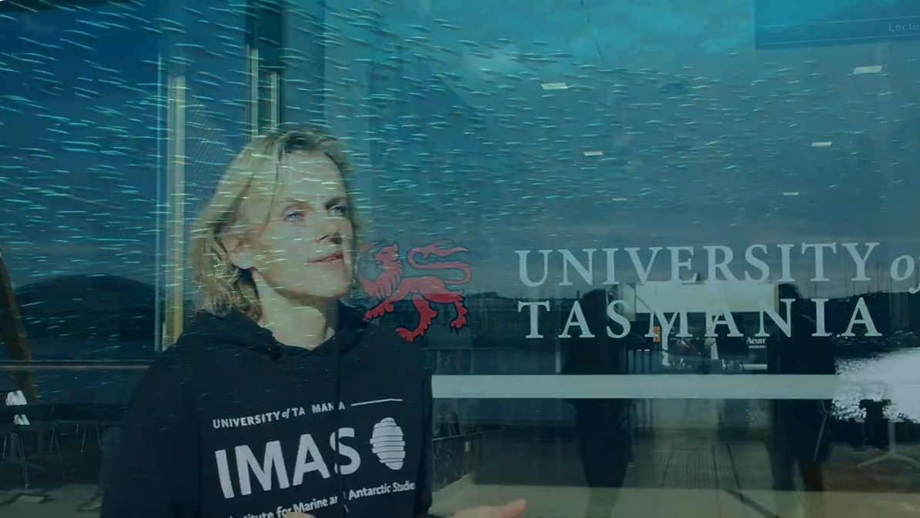
Tasmanian scientists, divers and fishers talk about the loss of big fish in Tasmanian waters (20 mins)
https://youtu.be/SXzuKqiTULI

Slide 25
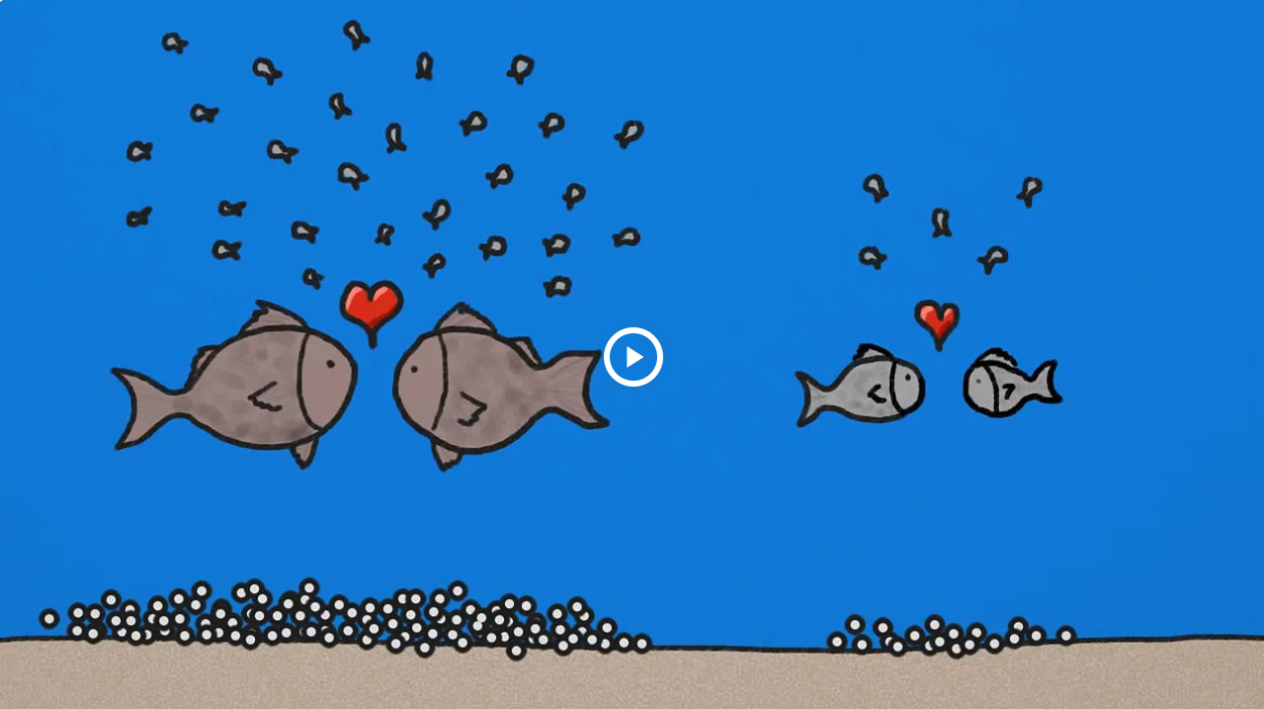
Encyclopedia Britannica short video about balanced harvesting and the importance of protecting large fish (2.5mins)
https://www.britannica.com/video/differences-fishing-harvesting-order-fish-supply-generations/-203963

Slide 26
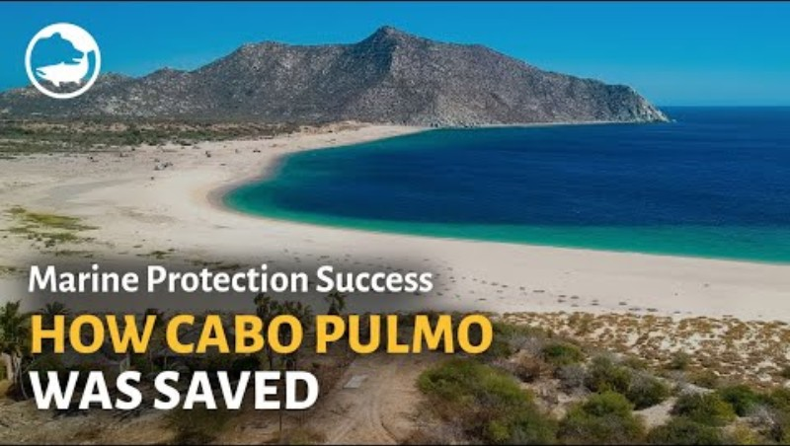
A short video (1.5mins) about rapid recovery of a degraded ecosystem in Mexico after establishing a community driven and well managed marine protected area (marine park)
https://youtu.be/YC6yUcCLQso

Slide 27
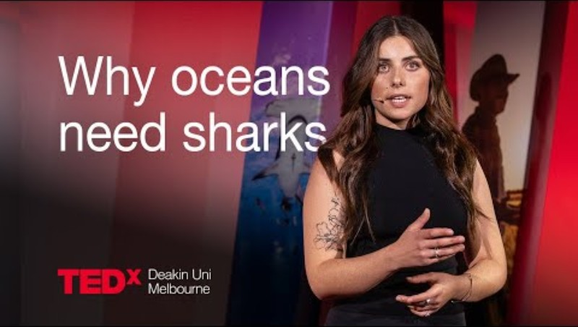
TEDx talk by a scientist Louisa Graf (Deakin University) about the importance of sharks for healthy ecosystems (9 mins)
https://www.youtube.com/watch?v=VcehrgZtGSY

Slide 28
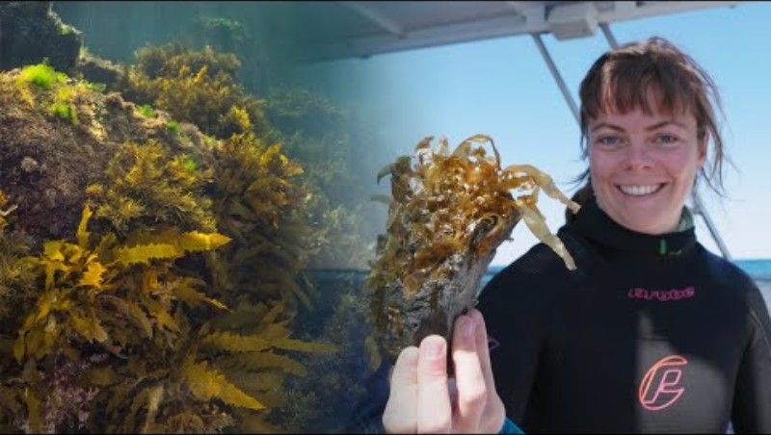
Great Southern Reef foundation video about kelp restoration methods that could be used on a large scale, introducing “Green gravel” technology (5 mins)
https://youtu.be/6plPl3RZJxs

Slide 29
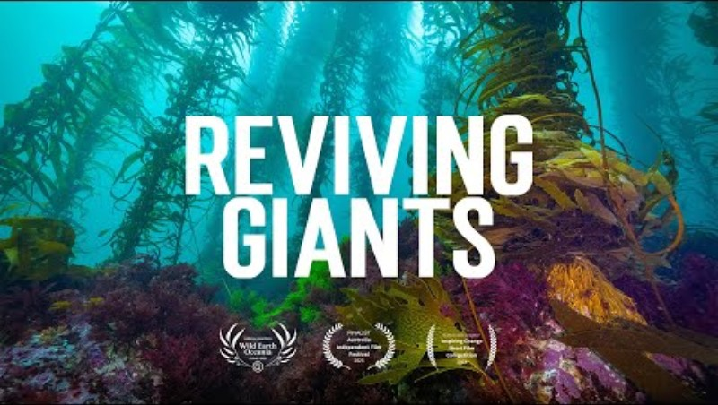
Great Southern Reef foundation film about the loss and restoration of Tasmania’s giant kelp forests (10 mins)
https://www.youtube.com/watch?v=rCRncbD1X7g

Slide 30
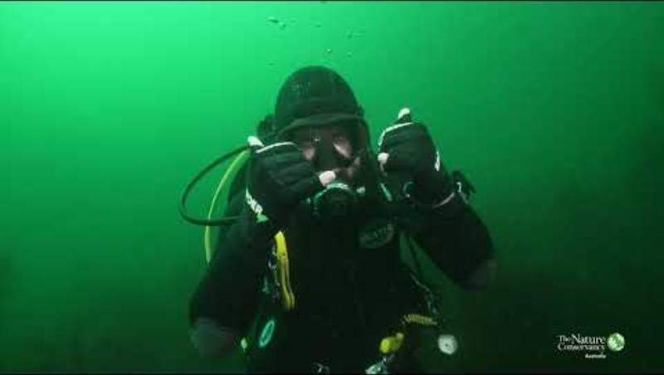
Inspiring Nature Conservancy (NGO) video (from 2025) about kelp restoration in Tasmania and engaging commercial divers. They talk about resilience of healthy restored kelp to heat waves (4 mins)
https://youtu.be/6mgaf-SqL9o

Slide 31
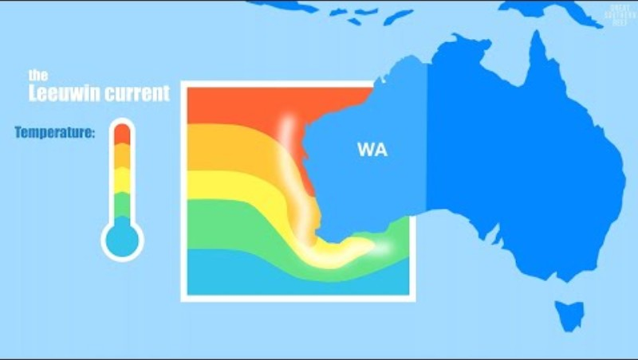
Great Southern Reef foundation film about heatwaves (especially Western Australian heatwave) and they affect Australia’s marine life (4 mins)
https://www.youtube.com/watch?v=1jQH6ZG11zU

Slide 32
Expanding into Year 11 Lessons
Instead of framing the lesson as playing a game, frame it around the concept of using the game as a model to improve understanding
In Year 11 Biology Unit 1, students are expected to investigate ecosystems as dynamic systems (biotic + abiotic factors) and use science inquiry skills: posing questions, designing an investigation, analysing data, evaluating limitations, and communicating evidence-based conclusions.
The Big Fish activity becomes the model system they run repeatedly under different conditions (treatments), then analyse like an experiment.

Slide 33
Expanding into Year 11 Lessons
- We suggest that year 11 students create, evaluate and compare multiple ecosystem restoration approaches.
- These approaches may include combinations such as marine protected areas and seaweed planting, or single solutions such as the rebuilding of a shellfish reef.
- Each game will have some elements of randomness which may decrease the effectiveness of even the best restoration strategy. The same happens in real life and students should explore that.
- The assessment can be more focused around the evaluation of options and the way in which the preferred option is presented in the ministerial brief, while accounting for the fact that no restoration strategy is 100% successful

